Slide 1
OpenWrt-Testlab
A combination of hardware and a test library to run tests on OpenWrt based routers
https://github.com/pmelange/openwrt-testlab

Slide 2
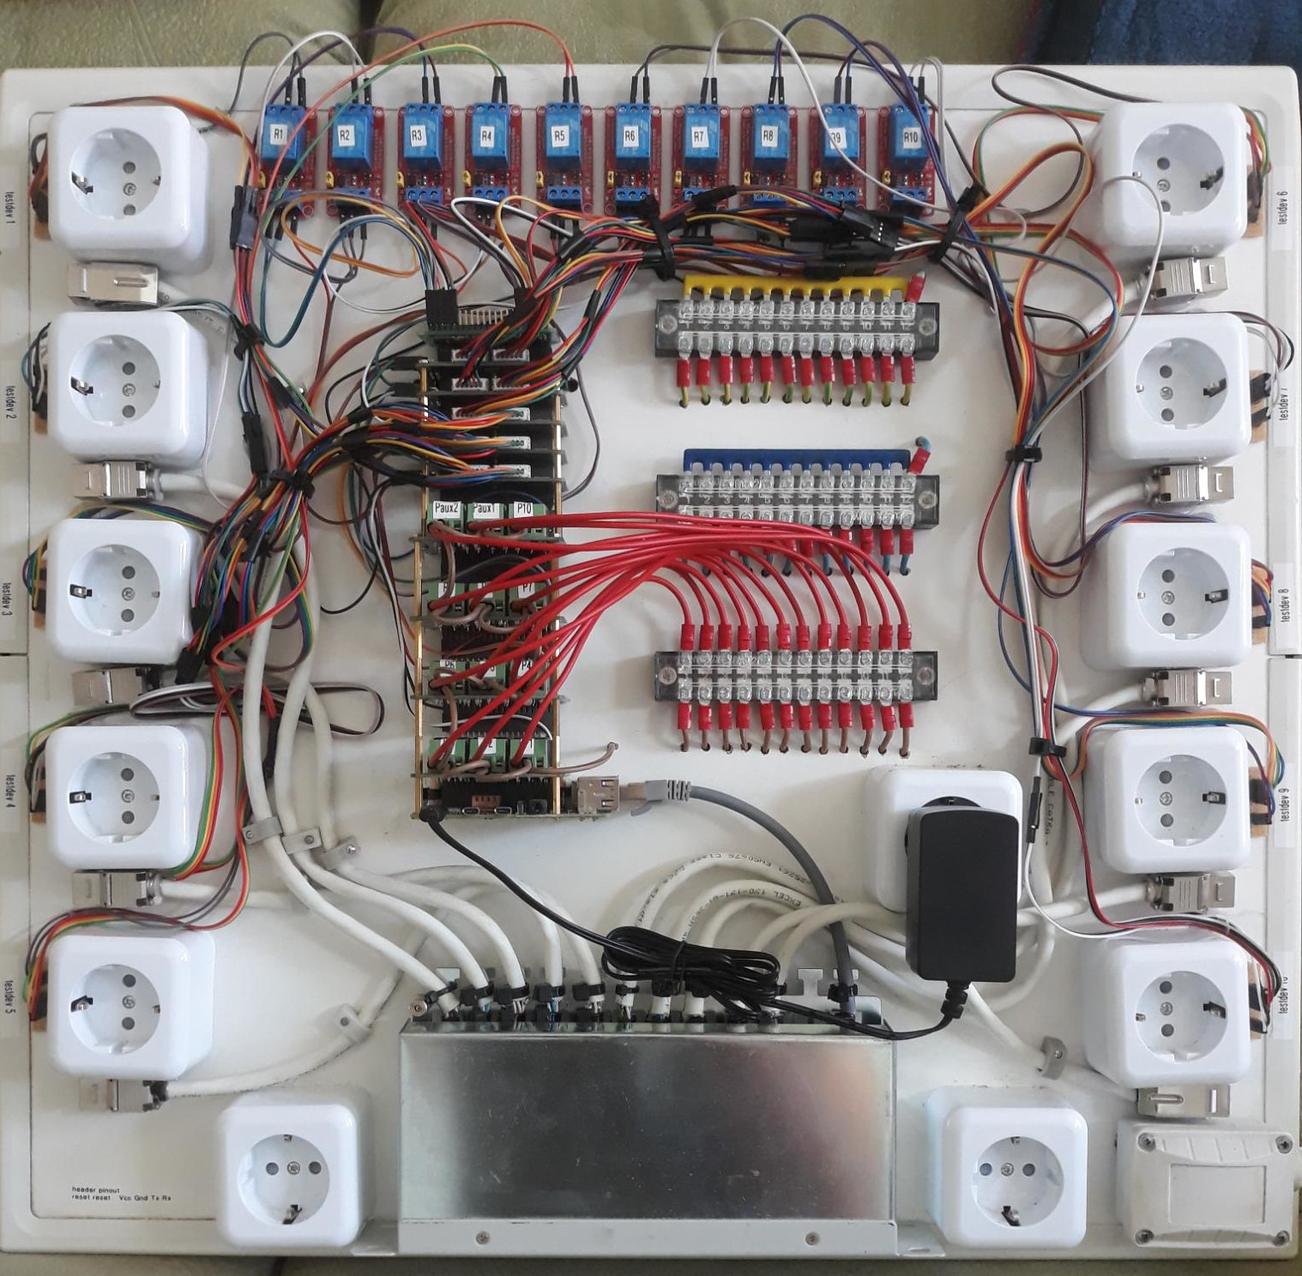
Hardware
Raspberry Pi 4B
4x Relay HATs (each with 3 relays)
5x SerialExpansion HATs (each
with 2 UARTs and 10 GPIOs)
10x Relays
12x Power Sockets
10x RJ45 Jacks

Slide 3
Routers
Each router connected to the testlab needs to have some minor alterations. The serial interface needs to be available (soldering pins and running jumper cables) and the reset button needs to have jumper cables soldered to the button’s activation pins.
Possibly modifications to U-Boot settings

Slide 4
Automation and Tests
Labgrid exports resources from the testlab for users to acquire when running a test (network port, serial interface, power, reset button)
Labgrid and pytest are used to automate flashing, filling out the wizard, and running tests
Possibility to add CI integration (github/buildbot)

Slide 5
Types of Tests
Sanity Checks: Are daemons running? Is there still flash space available?
Proof of Concept: Is there a new feature? Test it here first.
Simulations: Build a test mesh-network and throttle it until it breaks (or not).

Slide 6
Labrid
https://github.com/pmelange/labgrid is a fork of the project where I make modifications to their code. Some of the Pull Requests have been integrated upstream. Other PR’s are waiting.
In the openwrt-testlab repo there is an additional labgrid/ directory where testlab specific modules are located.

Slide 7
Labgrid (2)
Consists of the labgrid-coordinator, labgrid-exporter, and labgrid-client.
The labgrid-coordinator manages connections and resource reservations between exporter(s) and client(s).
The labgrid-exporter provides exported access to the hardware used to run the tests (power supply, serial port). There can be multiple exporters connected to one coordinator.

Slide 8
Labgrid (3)
The labgrid-client can be run from any computer which has ssh access to the exporter. Therefore it is possible to design new tests locally and run them on the testlab.
Any number of clients may connect to the exporter at the same time, but resources are only available after the client acquires them. There is a mechanism to wait for resources to become available again before acquiring them
Resources are grouped together into logical groups such as port1 and port2, each with it’s own network interface, serial port, etc.

Slide 9
pytest
https://docs.pytest.org
«The pytest framework makes it easy to write small, readable tests, and can scale to support complex functional testing for applications and libraries.»
Integrated directly into labgrid and therfore the python modules written in labgrid can be used within pytest.

Slide 10
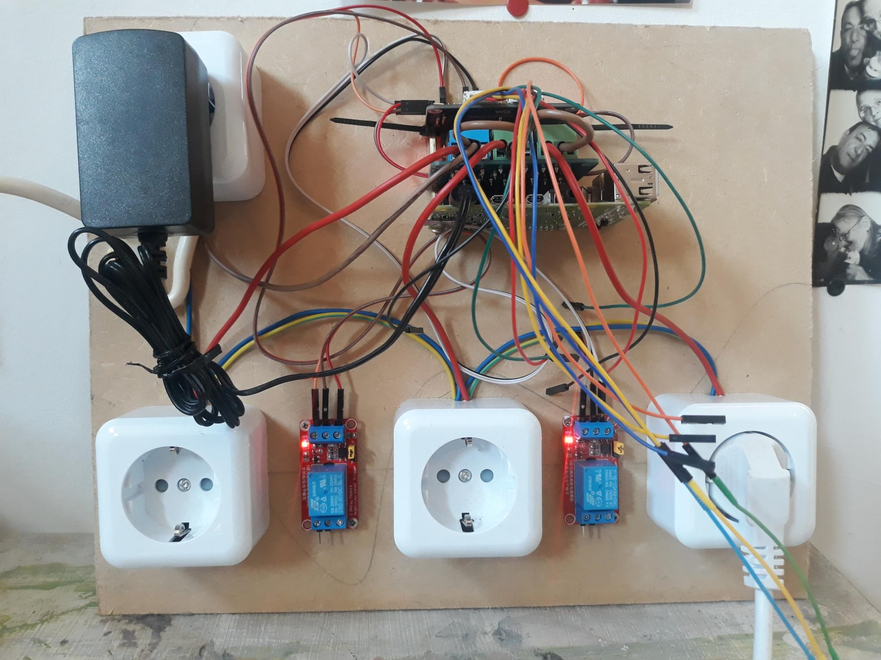
Demonstraton
If you have any questions, this is also a good time to ask.

